Slide 1

Funny Gorilla诙猩猩-IT培训
Your success is our success
Linux File System
Introduction

Slide 2
Learning Objectives
By the end of this learning module, you will be able to understand:
Linux File System
Some basic Linux commands

Slide 3
Linux File System

Slide 4

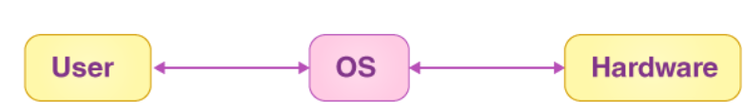
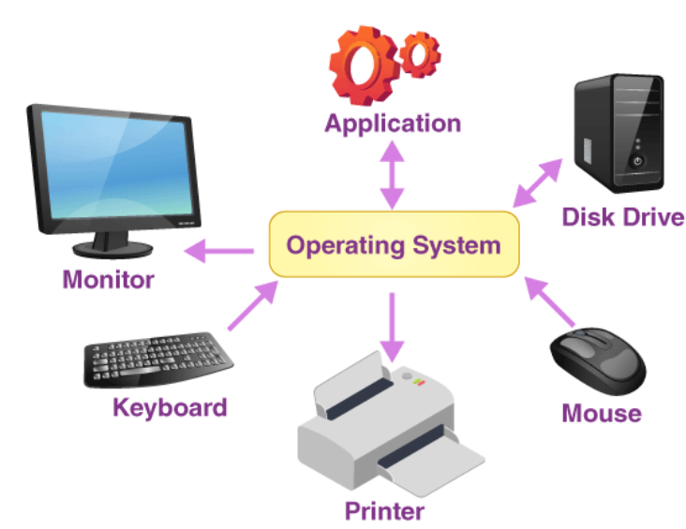
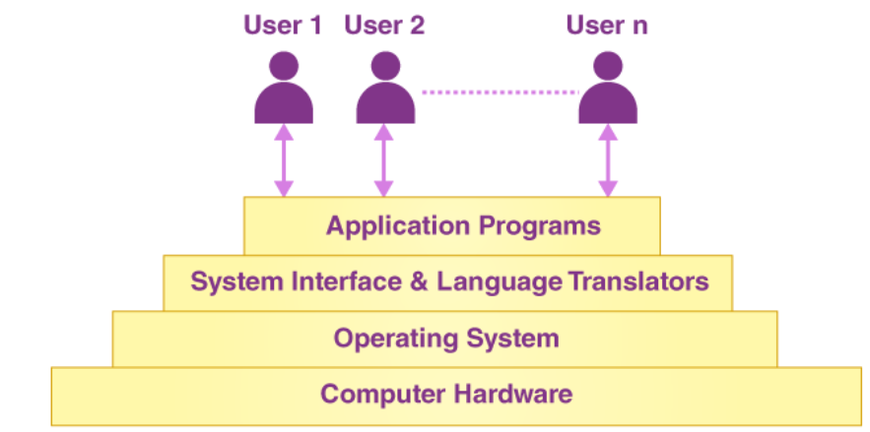
Computer

Slide 5
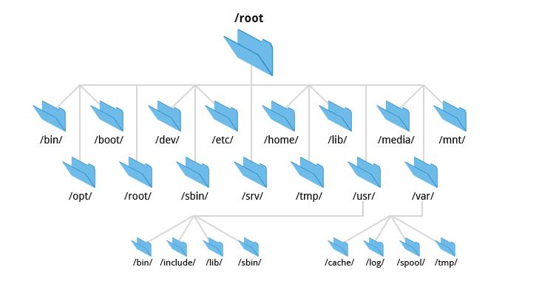

Slide 6

Contact
Your success is our success
Mail: info@funnygorilla.com.au
Linkedin: https://mt.linkedin.com/in/songqing-gu-2ba9034b/de
Web Chat: FunnyGorilla
Phone: 0420891343

